Slide 1
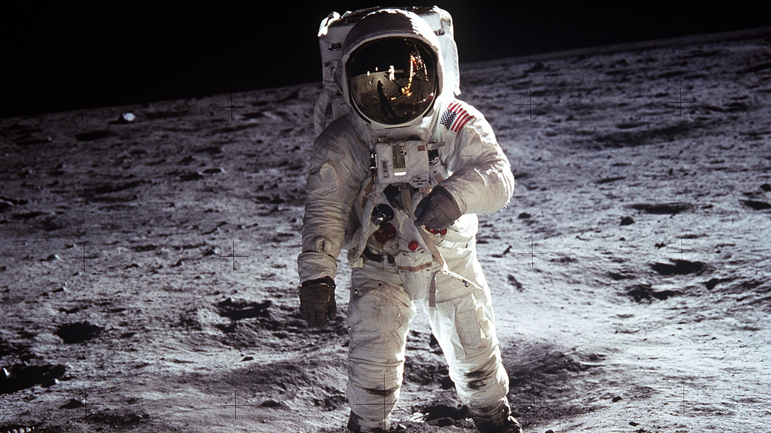
Galactic Odyssey
A text based space survival RPG
Lucy, Mark, Sam, John, Richard

Slide 2
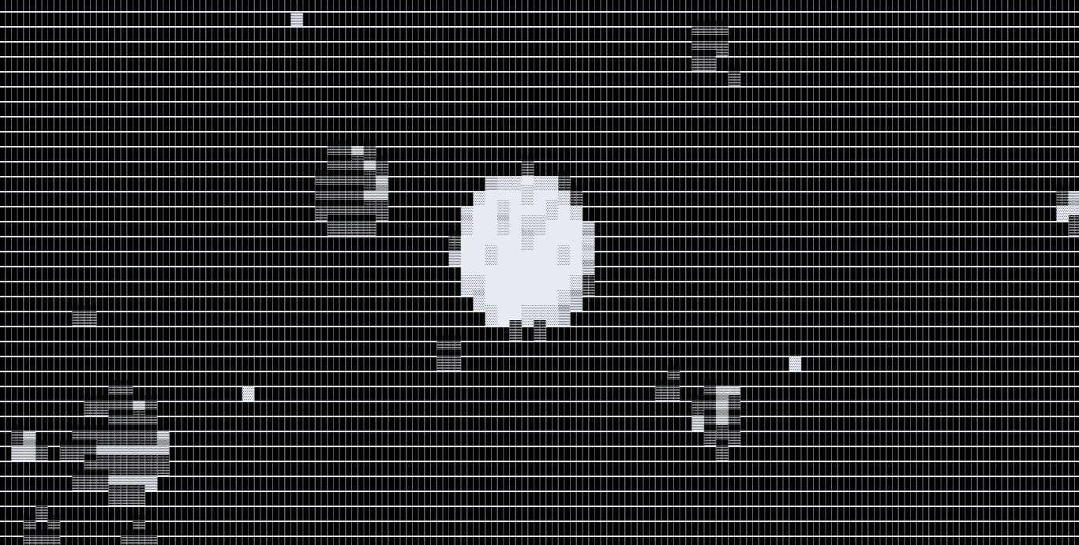

Slide 3
If there was a front end……
Advantages:
Audio could have been included to increase immersion.
Improved graphical design, more presentable.
Improved user navigation and interactivity.
Being able to play the game through a web browser rather than the terminal.
The design would be much more player friendly overall with improved presentation.
A chance to learn another programming language and gain further experience for potential job roles.

Slide 4
Improved design also introduces problems:
The required knowledge of a second programming language.
The project length and would increase.
The process of debugging would be twice as long and twice as complicated.
Planning a user interface and layout then implementing it would require far more research further increasing project length.

Slide 5
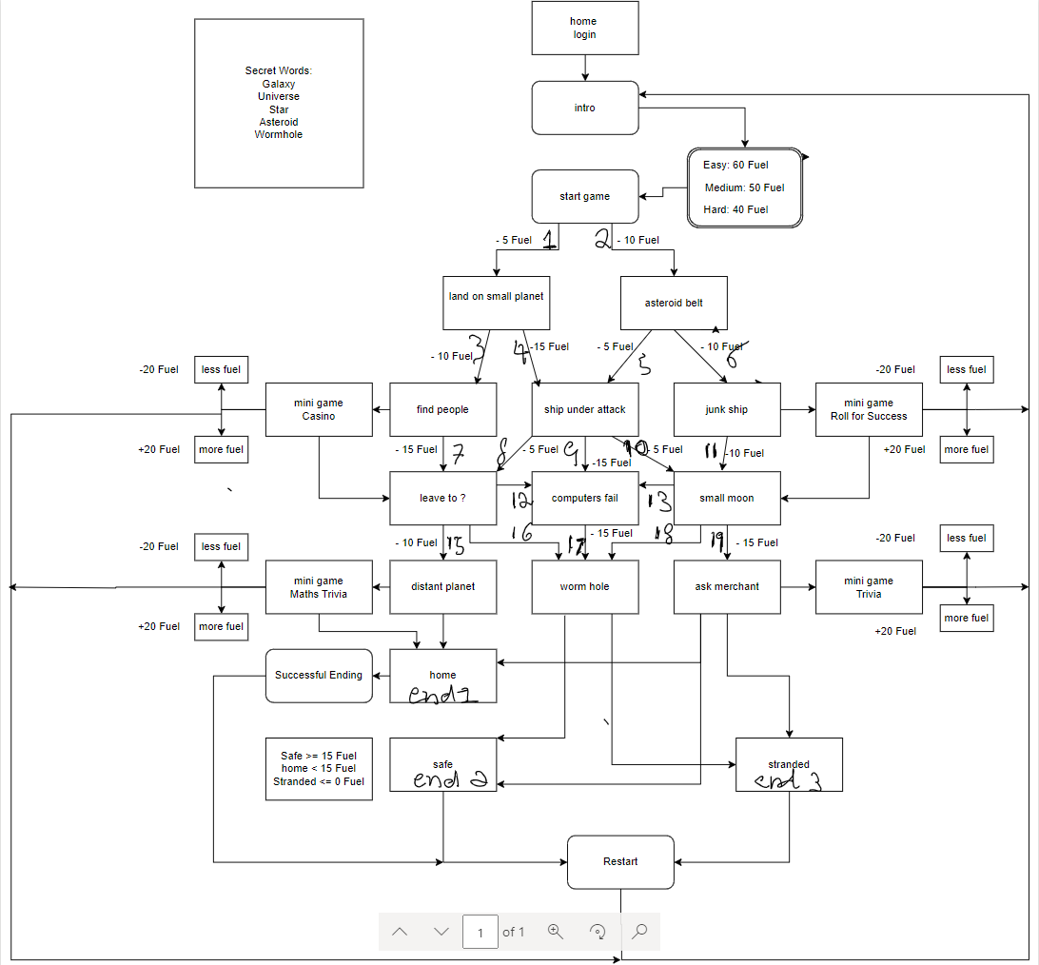

Slide 6
Planning on Draw.IO
Allowed for a thorough map of in game paths that was easy to read and put into use.
Simple to use interface.
Linked to google allowing for collaboration.
Easy to download and submit the finished map for marking.

Slide 7
However…
There were issues logging in to use the program.
Problems sharing access and giving permission to edit the document.
There is a learning curve for first time users, with little instruction.
Aligning arrows and editing the document was complicated.

Slide 8
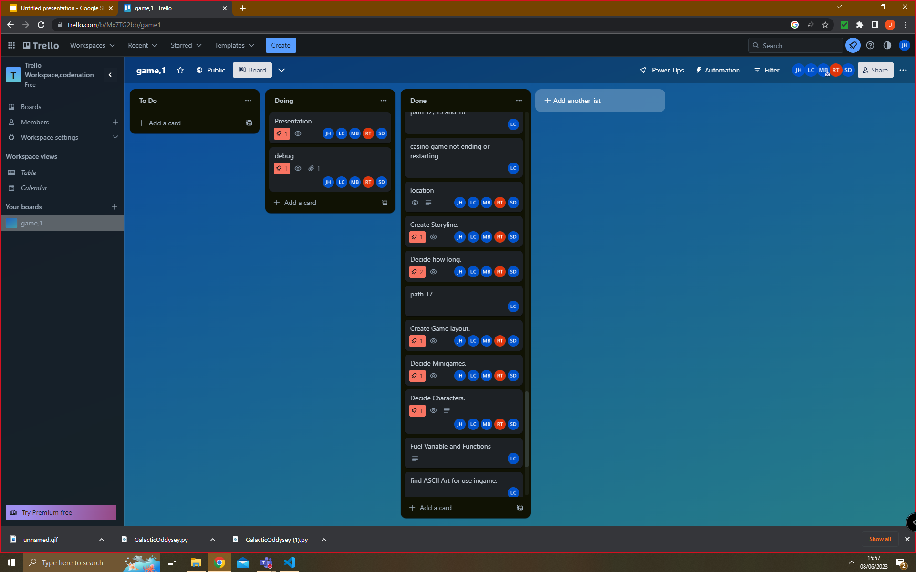

Slide 9
Using Trello:
Trello allowed for the easy collaboration and sharing of files between team members.
Role assignment was a quick and easy process improving ease of collaboration.
The sharing of ideas and opinions
Easy file sharing
Allowing copyable code to be added in description took some of the weight off the project.
Easy to track to do list.

Slide 10
Issues with Trello
Issues with uploading and sharing text.
When multiple people were adding text additions could be lost or fail to update properly.
Issues signing up to use the site.
Overall: It was a positive experience with some slightly irritating flaws.

Slide 11
The use of the Kanban style allows for….
Easy to visualise tasks and progress.
Easier to track tasks as they are being completed, ease of task sharing streamlined the implementation of code.
The clean professional interface design made it much easier for the leader to coordinate and designate tasks.
Overall - increased the teams productivity and reduced the amount of time wasted. It was easier to highlight potential issues which streamlined the process of debugging.

Slide 12
Using teams: The good
Improved accessibility - file sharing, everything in one place.
Ease of communication - Voice chat, screen sharing, video calls, collaboration.
Support - Tutors are easily contactable.
Ease of use once the user has familiarized themselves with it.

Slide 13
And the bad.
Challenging to find files for new users.
Webcam and voice chat may not be comfortable with all users.
There may be issues accessing files if the app is not downloaded.

Slide 14
Testing and debugging:
The provided programs made the process smoother.
Issues could be quickly identified, fixed and the new file shared between users.
Being able to isolate problem parts of code made fixing issues easier.
Pieces of code were taken from each member of the group, the debugging process offered the chance to ensure there were no issues stitching the pieces together.
Offered a learning opportunity to see how problem solving could be applied to each bug.

Slide 15
Examples:
Endless loop in Math's trivia - fixed by isolating and editing while loop to remove lives after the quiz had ended
Log in screen: The log in would not read usernames and passwords from a list only from a string.
Secrets function: counting words that were not supposed to be counted as a secret.

Slide 16
Team Efforts: Mark
Team Leader
Directed efforts
I Set up Trello & Set up Draw.io
A large amount of play testing and debugging
Made two of the mini games
And more
Learnt from the experience
Trello and how it functions
Draw.io and that the arrows can have a mind of their own
Every person codes in their own way but if we work together, we can have amazing outcomes
I enjoyed making this game and trying different coding ways & working with the team

Slide 17
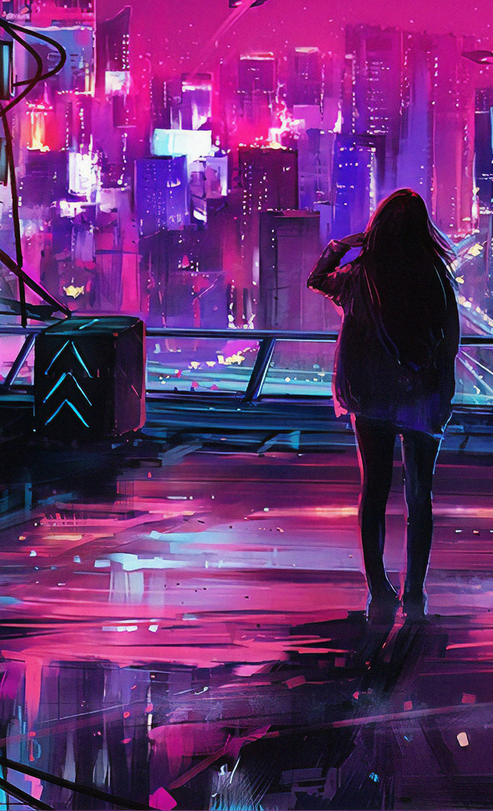
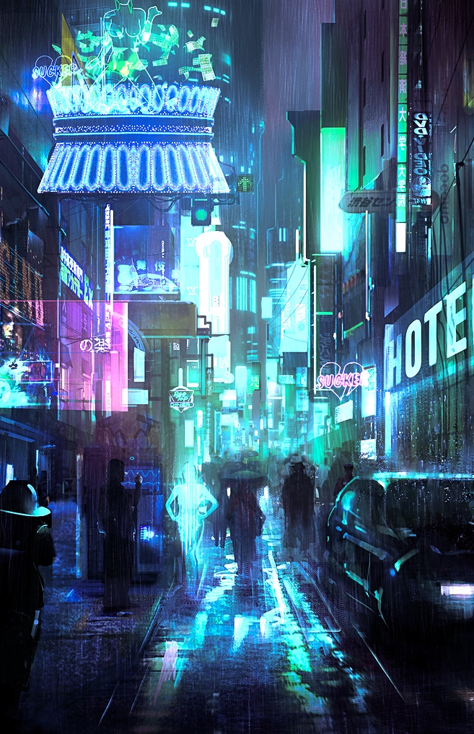
Team Efforts: Richard
Intro + Plot writer - wrote the intro to the game and a little back story of how our astronaut arrived to where the adventure began in deep space.
Wrote all the different plot points ensuring the gameplay remained consistent with the story - using the created flow chart to write all the choice paths and link together via a implemented numbered sequence for ease of coding, also did some print and sleep commands between lines.
Ideas to name the game.
Play testing the game.
Worked on the initial draft layout PowerPoint slides with John.
Learnt from the experience:-
Trello – Great collaboration tool for a team of coders and being able to test code at different stages of development.
Draw.IO - Good visualisation tool for working on the game as a team as everyone can input ideas together.
Saw how code can be all moulded together even though different people write their own individual different sections.
Different skillsets and knowledge levels can easily be applied to different parts of the task.

Slide 18
Team Efforts: Sam Dobie
Creator of the Casino mini game
Creator of the Secret mini game
Play testing
Helped design the genre and theme
Helped with the flow chart
Making these games helped me implement my knowledge of conditional statements, loops, and the random module.

Slide 19
Team Efforts: John
Contributed to design ideas.
Created the maths quiz.
Applied Lucy's code to create a couple of the functions for the pathways
Learned a lot around applying problem solving skills in coding by watching Lucy and Mark debug issues no one else could fix.
Learned about how functions can be applied in different ways to make the overall code more elegant.
Worked on the PowerPoint.
Would like to give a big thank you to the rest of the team.

Slide 20


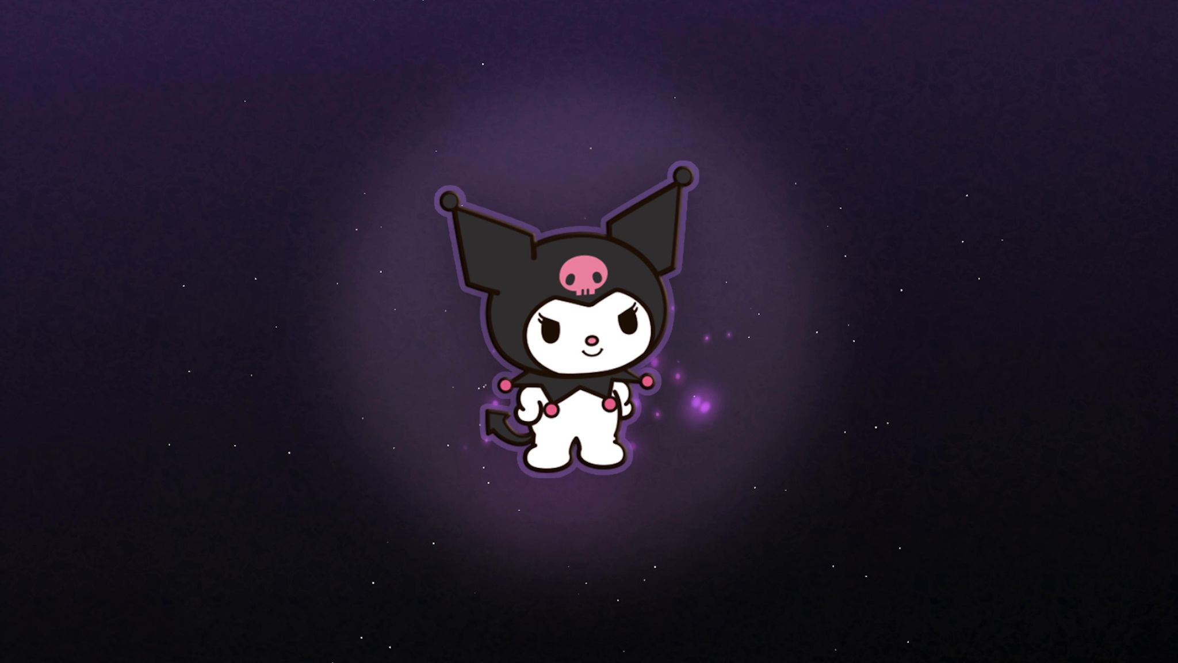
Lucy Conway
What I did.
I designed the skeleton and framework of the game in code, This gave a guideline for people to follow
I Advised the group on whether the ideas they wanted were possible to Implement, meaning we didn’t have any impossible tasks.
I created a lot of the functions and variables to work with the structure of the Game and rewrote and stitched everyone else’s code together including minigames
What I got out of it..
I learned to read other people’s code better and to be able to change and Manipulate it to work with mine.
I learned how to use Trello and the kanban system to manage tasks a lot Easier and keep on top of everything better.
I became more comfortable in working in a group environment on a Product like this and focus on implementing other people’s ideas.
• Designed the new game and load game functions.​
• Designed the log in screen.​
• Found ascii arts and made them a part of the game.​
• A huge amount of testing and debugging.​
• Main advisor to the group and curator of the overall code.​
• Created the function for the secrets within the game.​
• Ensured the functions lead to the correct paths within the story.
• Helped the leader with prioritization.​
​• Taught coding concepts to the rest of the team, advising on proper use of syntax and the most efficient ways to use coding concepts.​
​• Taught the importance of the proper use of functions.​
​• Always valued the input and ideas of the rest of the team. ​
​• Encouraged participation and coordinated team efforts.

